Slide 1

Study, modeling and simulation of pedestrian walk with regard to the improvement of stability and comfort on walkways
School of Electrical & Computer Engineering
Statistical Model of Human Walk
Pavlos Paris Giakoumakis
AM: 2013030045
Thesis project - Erasmus+ internship at University of Modena & Reggio Emilia (UNIMORE)

Slide 2

Variables Describing Human Walk
The human walk is described through four variables
$F_{k}$: The mean vertical force applied at the $k^{th}$ step - related to the weight and gait of the pedestrian
$Δt_{k}$: The time interval between the $k−1^{th}$ and $k^{th}$ step
: The length traversed between the $k−1^{th}$ and $k^{th}$ step
$θ_{k}$: The direction of the $k^{th}$ step (angle between the $k−1^{th}$ and $k^{th}$ step)
Human steps are never identical
Pedestrian walk is modeled as a series of steps where each parameter of a given step is independent of those of the previous steps
The model is memoryless and unable to describe some events i.e. a stumble or a collision

Slide 3

The Model
The mathematical model uses a Markov chain application called random walk
The position of each pedestrian is a sequence - each step’s position depends exclusively on the position of the previous step
The pedestrian is walking towards an endpoint, therefore its direction cannot be uniformly distributed
The state of the Markov chain at the $k^{th}$step is described as $S_{k}=\{F_{k}, Δt_{k},l_{k},θ_{k}\}$
The Markov chain is continuous in the state space $S$ and discrete in time
The steps are independent and identically distributed (i.i.d.)
Transition probability density function (pdf): $p(S)=p(F, Δt,l,θ)$

Slide 4
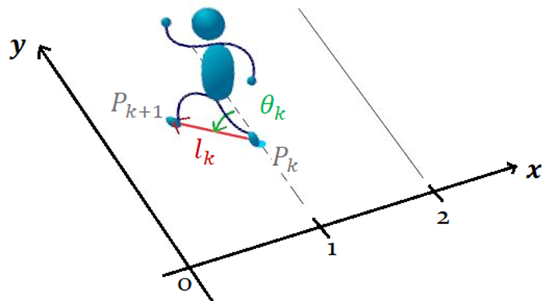
Geometrical Interpretation

Slide 5







The Model
The correlation between the $4$ variables describing the human walk was extracted by Martina Fornaciari
Correlation coefficients of distinct variables have been assessed and then averaged over the number of students in order to devise general indications.
The $Dt$-$F$, $Dt$-$l$ and $F$-$θ$ correlations are important - any other correlation can be considered negligible
$Dt$, $F$ and $l$ are correlated, while $θ$ is statistically independent from the others
$$Dt$$
$$F$$
$$l$$
$$θ$$
The average matrix correlation between the variables as extracted by Martina Fornaciari
Thus, the pdf $p(S)$ can be written as:
$$p\left(S\right)=p\left(F,Δt,l,θ\right)=p\left(F,Δt,l\right)p(θ)$$

Slide 6
Gaussian Mixture Modeling
A Gaussian Mixture Model (GMM) is a probabilistic model for representing normally distributed subpopulations within an overall population
Parameterized by the mixture component weights, means and variances/covariances
The component weights are the a-posteriori estimates of the component probabilities given the data
GMMs are an interesting approach to this work
They depend on a limited number of parameters
Can accurately approximate several practical distributions
Can rely on simple algorithms
A successful representation of the problem (as eventuated by the work of Thomas Caleri)

Slide 7

Gaussian Mixture Modeling
Let a GMM with K components. The $k^{th}$ component has:
Mean: $m_{k}$ for the univariate case and ​$μ_{k}$ for the multivariate case
Variance/covariance: $σ_{k}$ for the univariate case and $Σ_{k}$​ for the multivariate case
Mixture component weights: $φ_{k}$ ​with the constraint that $\sum_{i=1}^{K}{φ_{i}=1}$ - the total probability distribution normalizes to $1$
pdf of a GM based on K components
Univariate case (modeling $θ$):
$\hat{p}\left(θ\right)=\sum_{i=1}^{K}{φ_{i}N(m_{i},σ_{i}})$ where $N\left(m_{i},σ_{i}\right)=\frac{1}{σ_{i}\sqrt{2π}}exp\left(−\frac{{\left(x−m_{i}\right)}^{2}}{2σ_{i}^{2}}\right)$
Multivariate case (modeling $F,Δt, l$):
$\hat{p}\left(F,Δt,l\right)=\sum_{i=1}^{K}{φ_{i}N(μ_{i},Σ_{i}})$ where $N\left(μ_{i},Σ_{i}\right)=\frac{1}{\sqrt{{\left(2π\right)}^{3}\left|Σ_{i}\right|}}exp\left(−\frac{1}{2}{\left(\vec{x}−{\vec{μ}}_{i}\right)}^{T}Σ_{i}^{−1}(\vec{x}−{\vec{μ}}_{i})\right)$
The transition pdf $p(S)$ is therefore approximated as:
$$\hat{p}\left(S\right)=\hat{p}\left(F,Δt,l\right) \hat{p}(θ)$$

